Slide 1
Photo Album
by Dell Vostro

Slide 3
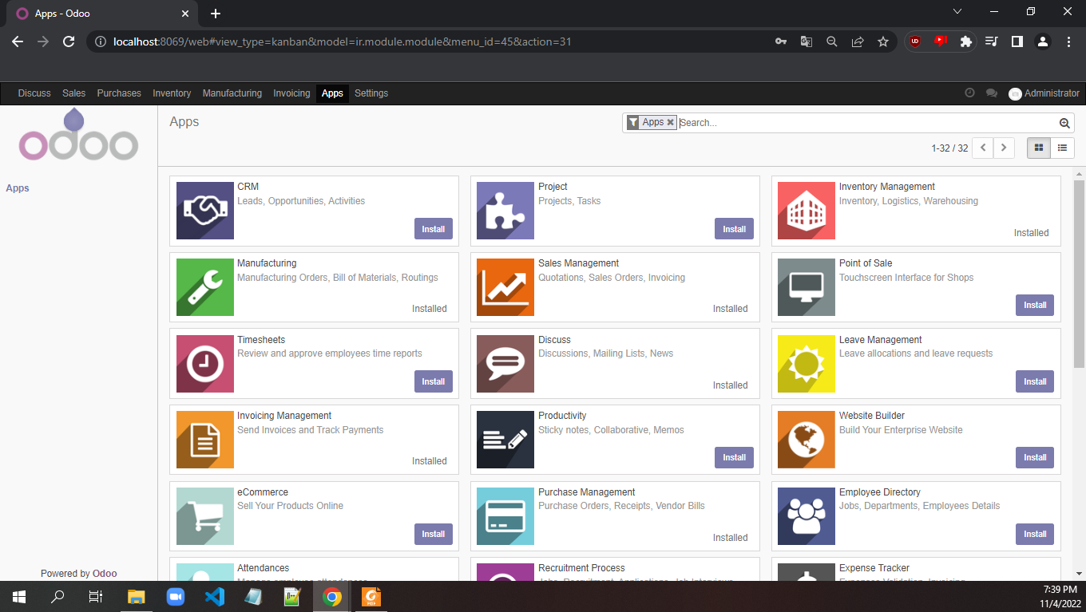

Slide 4
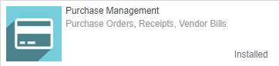
Download Purchase Module

Slide 5
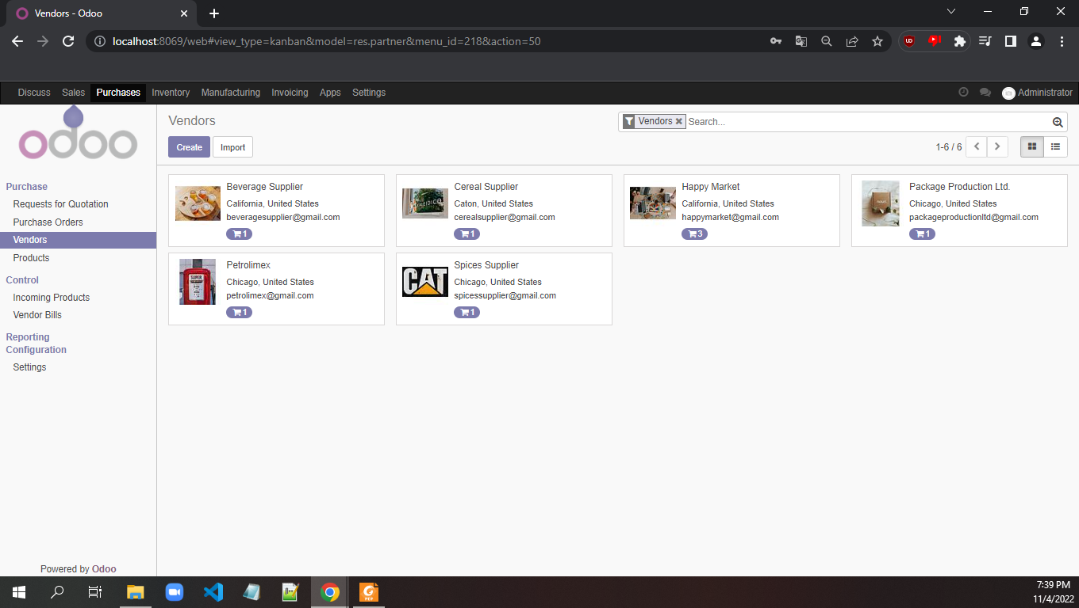
1/ Go to tab Products 2/ Under Purchase click Vendors
3/ Create Vendor

Slide 6
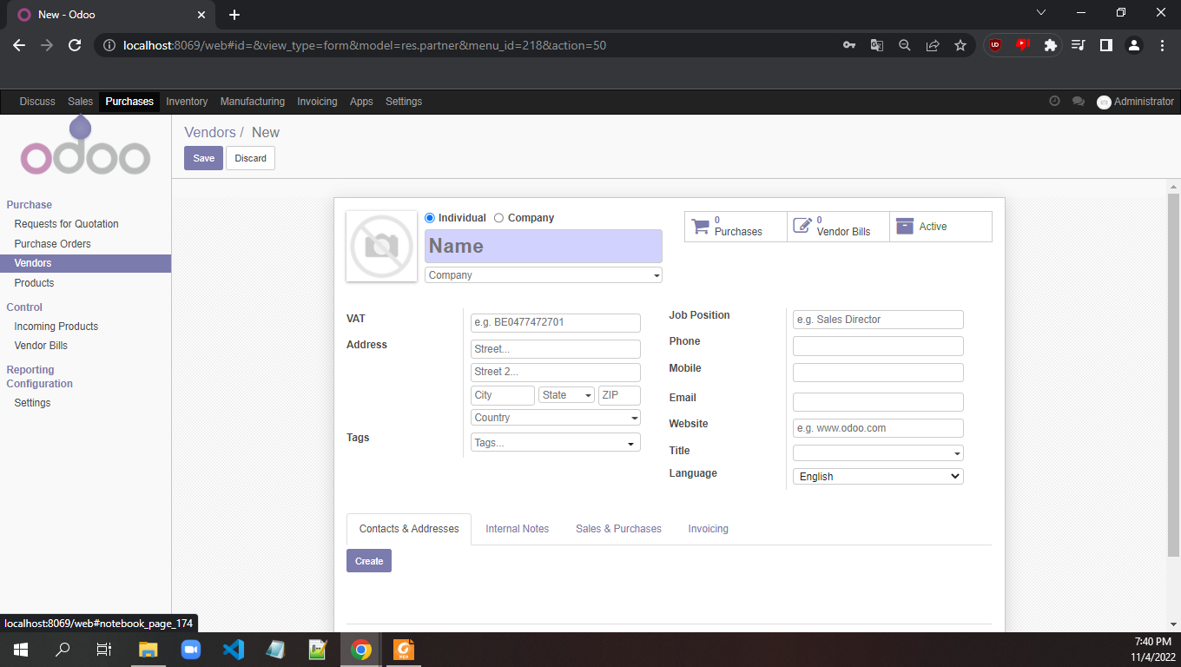
1/ Must fill Name and decide this Vendor is a Individual or a Company
2/ Fill out the other information
1/ Check the Sales & Purchase tab
2/ Check the Invoice

Slide 7
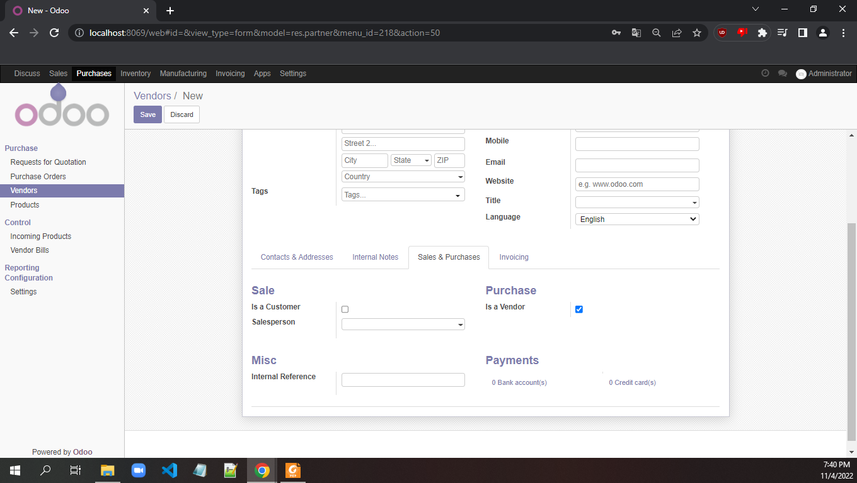
1/ Within the Sales & Purchase tab check under Purchase as Is a Vendor

Slide 8
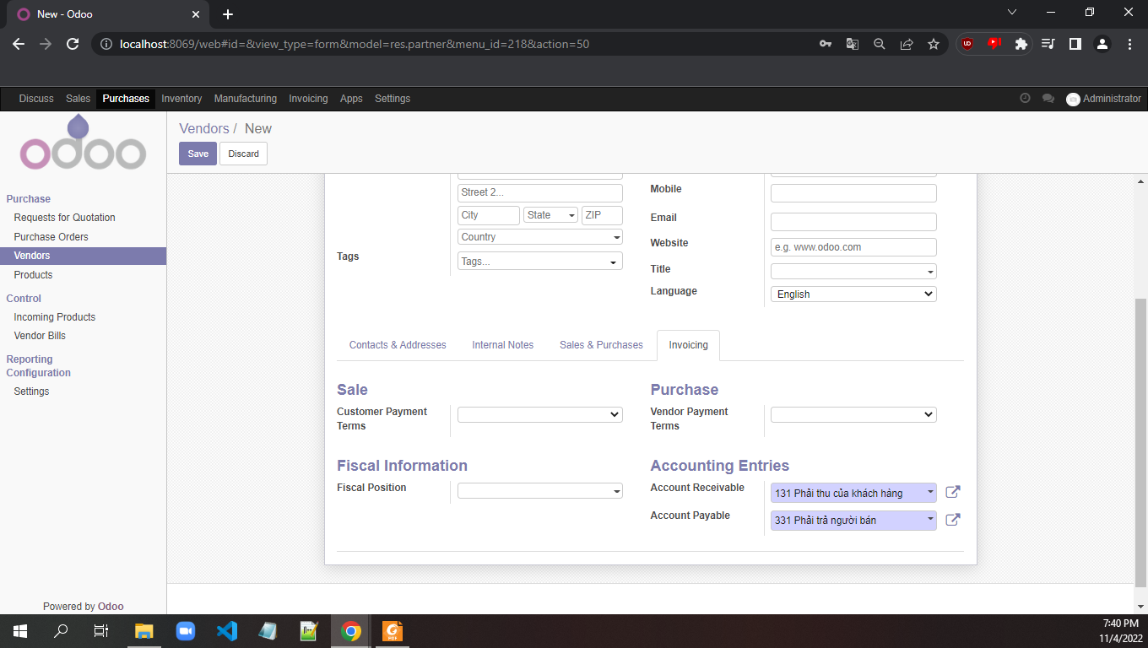
1/ In Invoicing tab, choose for both Sale > Customer Payment Terms and Purchase > Vendor Payment Terms as 15 days

Slide 9
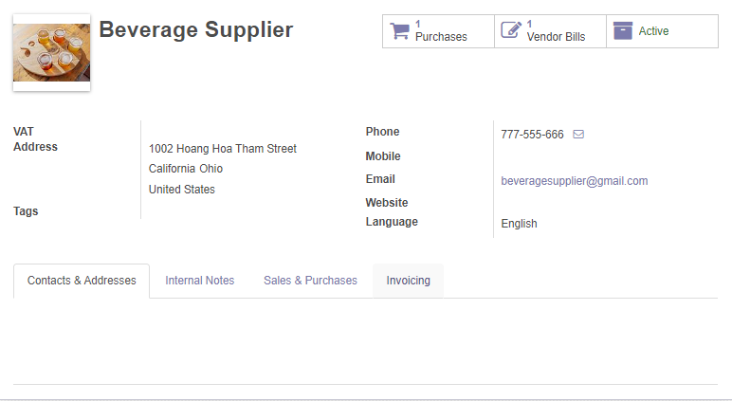
1/ This is our vendor with all the information filled out

Slide 10
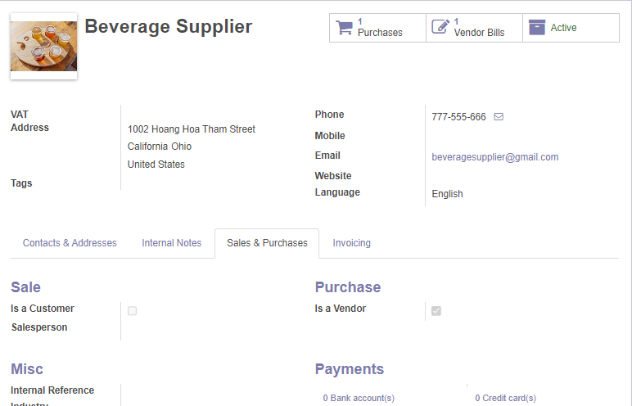
1/ This is our vendor with all the information filled out in Sales & Purchases tab

Slide 11
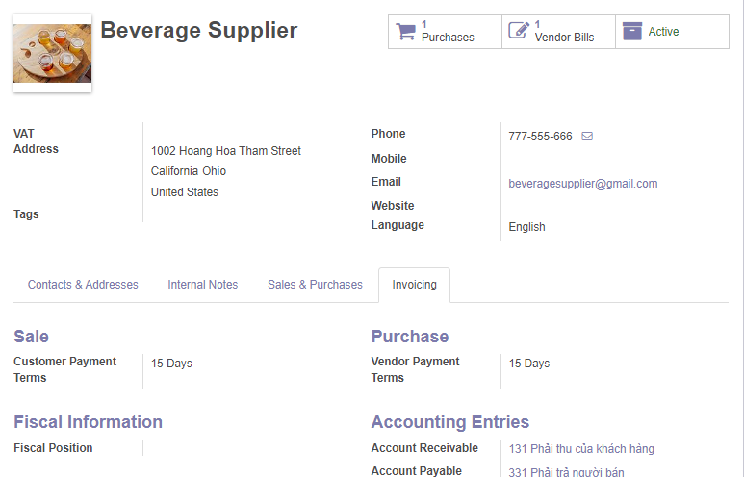
1/ This is our vendor with all the information filled out in Invoicing

Slide 12
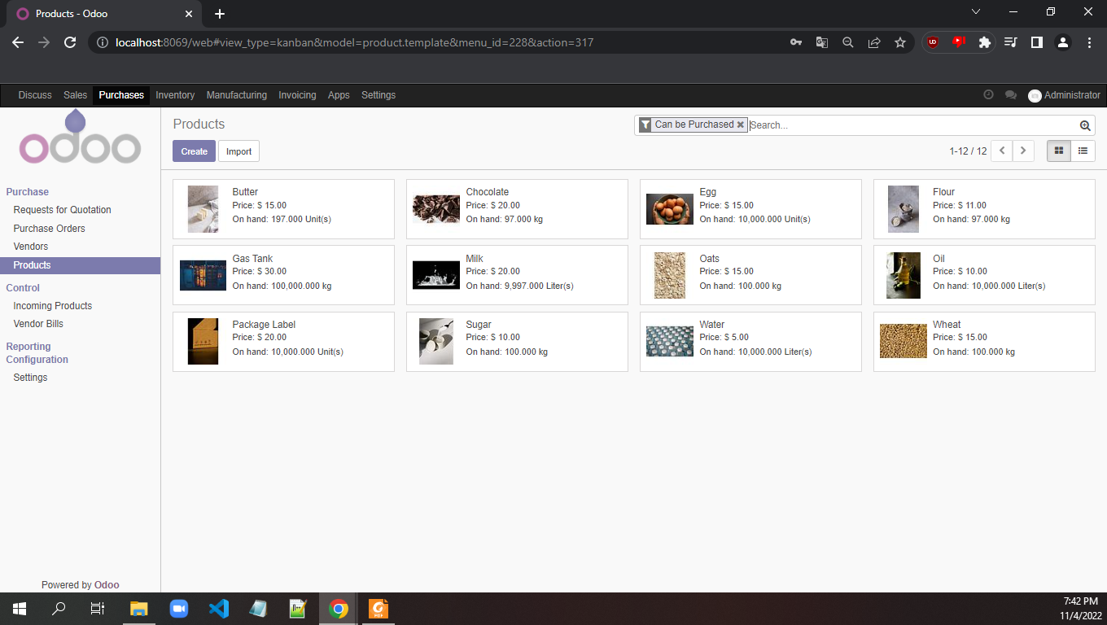
1/ We now create our product by going to Products tab and click Create

Slide 13
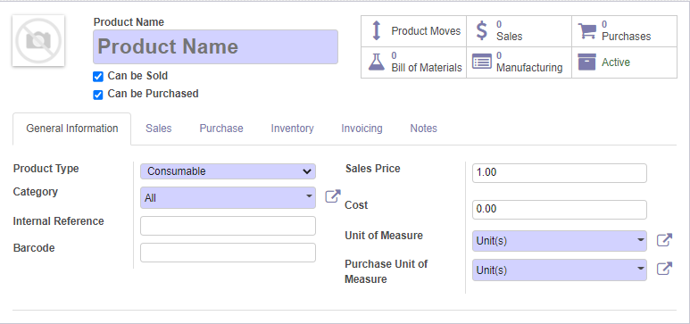
1/ We fill out information for our product
2/ Remember to uncheck the Can be Sold be cause this is a material

Slide 14
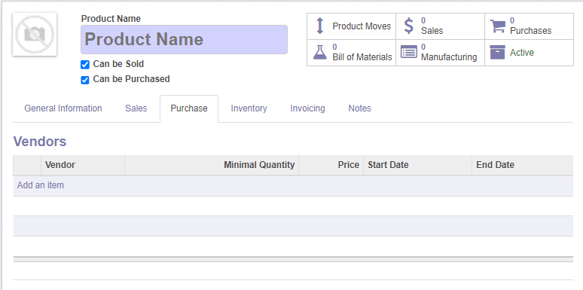
1/ In tab Purchase, we will add our vendor that we previous created

Slide 15
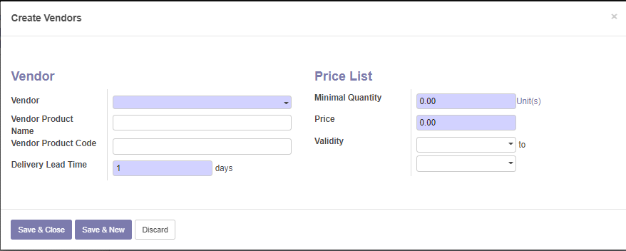
5/ Price list > Minimal Quanity, the minimum quantity that we shall import from this vendor
6/ Price of a single unit that we import from this vendor (note: product but different price based on the vendor)
1/ Choose the vendor
2/ Choose the product that this vendor supplies (you should create based on the name of the material that this vendor supplies)
3/ Type vendor code
4/ Lead time, is time process, we should leave at 4 days

Slide 16
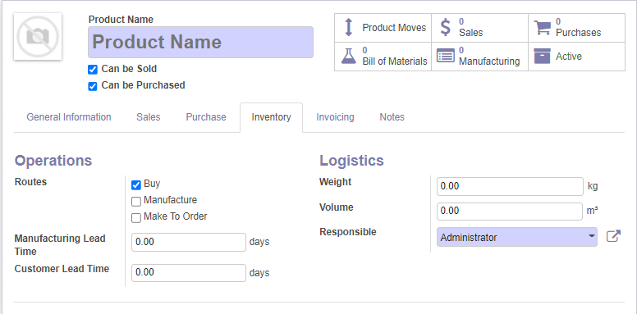
1/ In the Inventory tab, we choose only the Buy route because we gonna buy these material to create a product

Slide 17
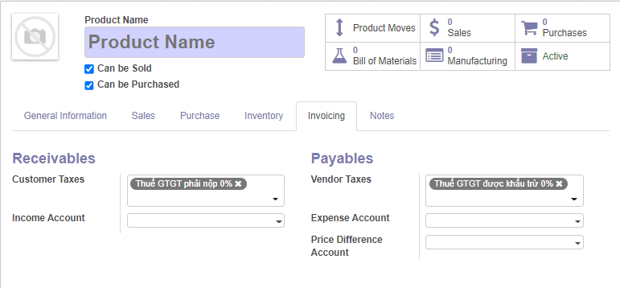
1/ In Invoicing, we choose the tax, we will give both Receivables and Payables both 5% tax

Slide 18
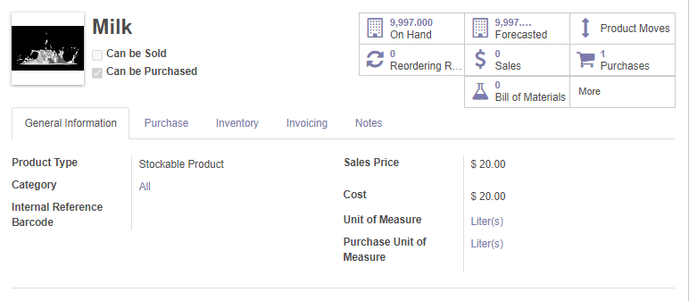
1/ This is the finished material page

Slide 19
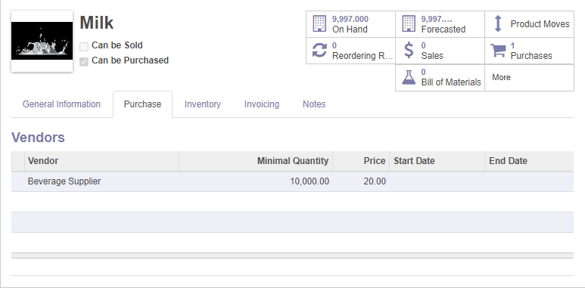
1/ We added our vendor is Beverage Supplier

Slide 20
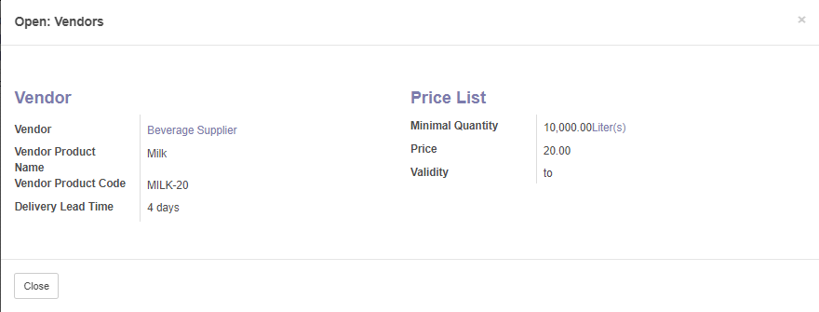
1/ Our vendor have the information on the left
2/ It also have the price per unit and quantity each import

Slide 21
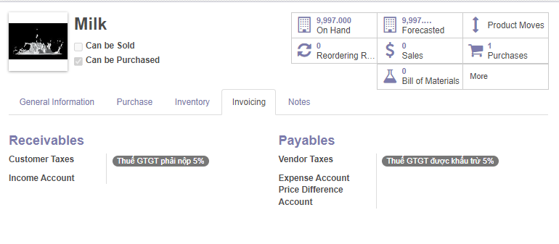
1/ In Invoicing tab, we have our taxes at 5%

Slide 23
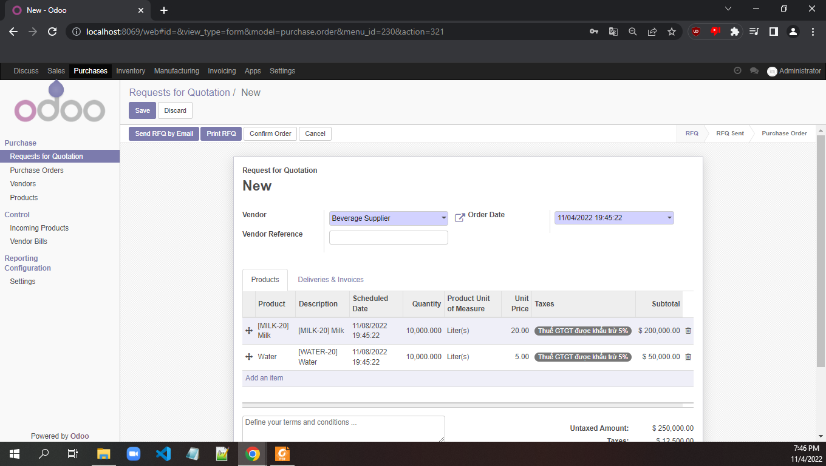
1/ We start to purchase the materials by choosing Requests for Quotation
2/ We choose Vendor and add Products
3/ Click confirm order to confirm

Slide 24
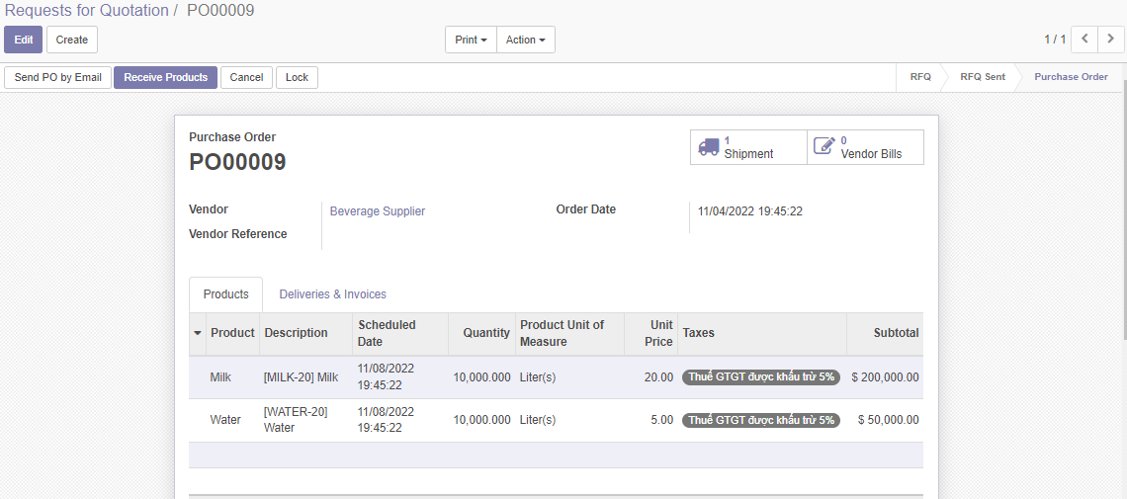
1/ After requests, we choose receive products

Slide 25
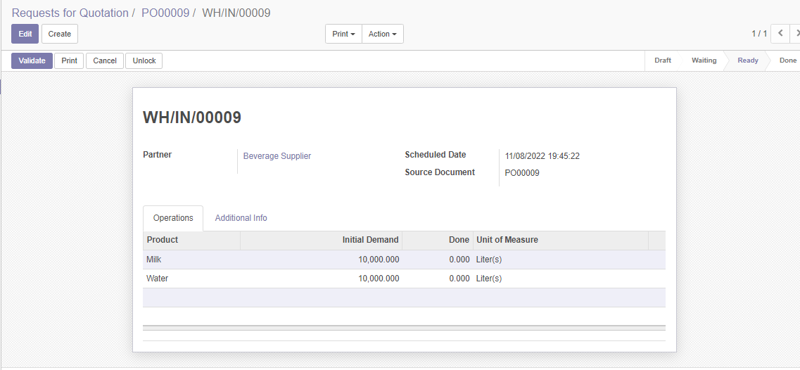
1/ We will check the quantities of materials
2/ We click Validate after checking
3/ The Done column will be auto filled after clicking validate

Slide 26
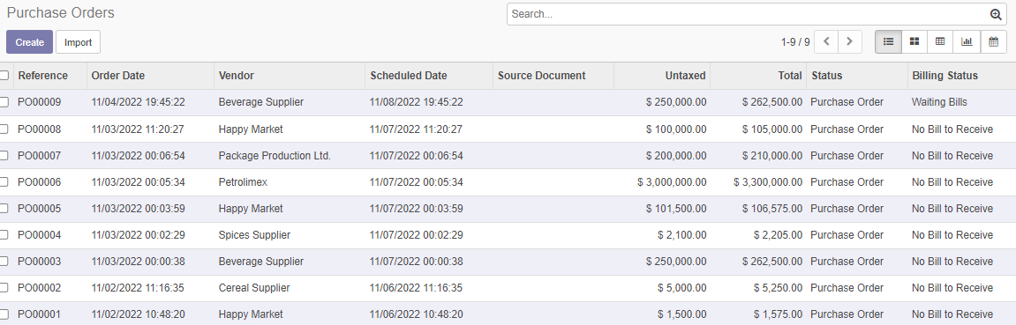
1/ We see that in Purchase Orders will have a new order
2/ But Billing Status is Waiting Bill because although we receive the materials but we have not pay the vendors

Slide 27
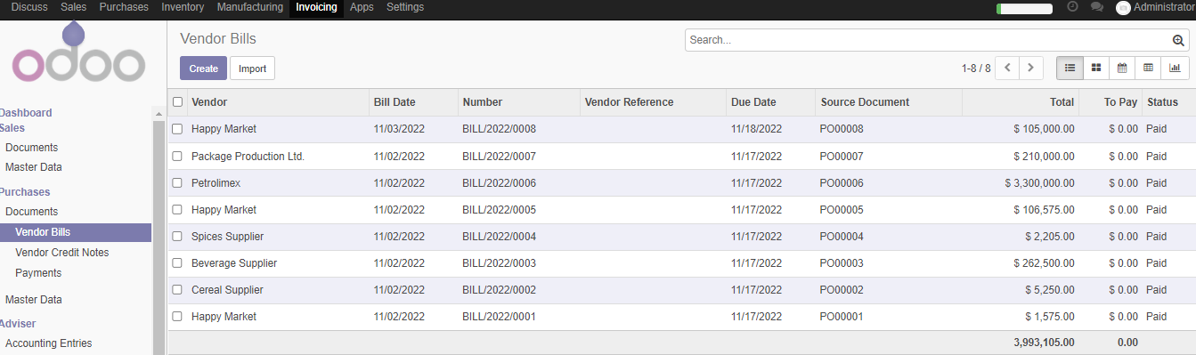
1/ Go to Invoicing > Under Purchases > Vendor Bills > click Create to create new Vendor Bill

Slide 28
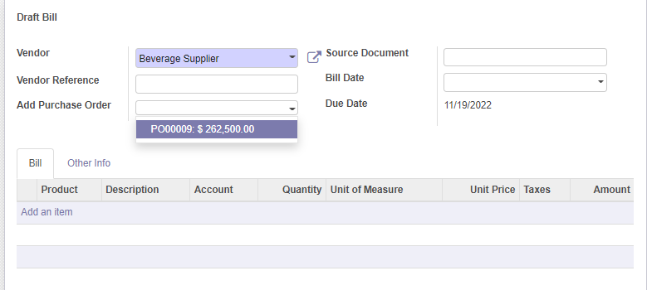
1/ We choose the vendor we want to pay
2/ Odoo will automatically check for any Pos that is currently unpayed and suggest, for example, this time Beverage Supplier has a PO00009 that is currently unpayed
1/ Odoo will automatically fill out the items that are in the bill

Slide 29
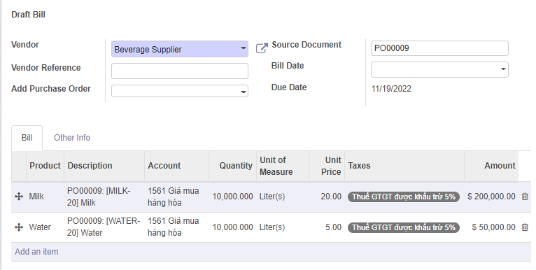
1/ This is the complete draft bill, containing Name of the vendor, PO of the vendor that is currently unpayed and materials of that bill

Slide 30
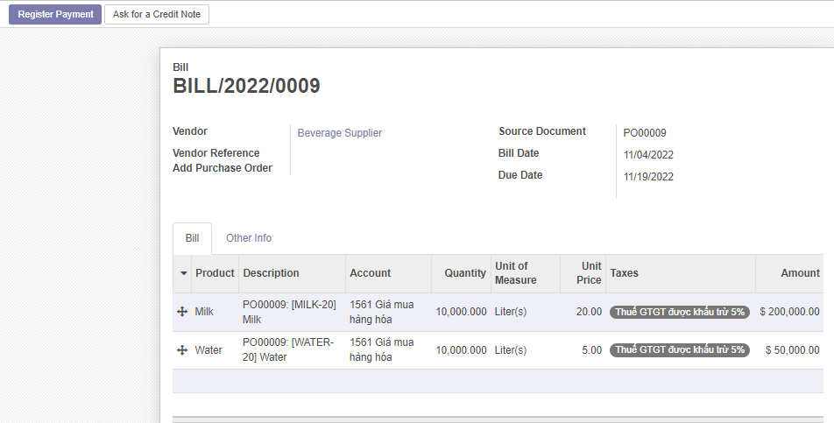
1/ We click register payment to register our payment for our vendor

Slide 31
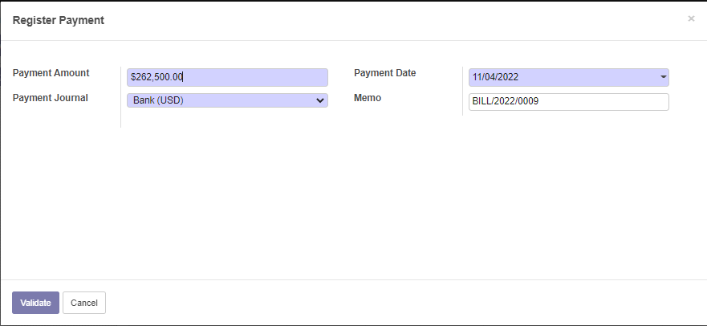
1/ Odoo will automatically display the amount we need to pay
2/ We choose the payment method, this time we choose the Bank method
3/ After that, we Validate Payment

Slide 32
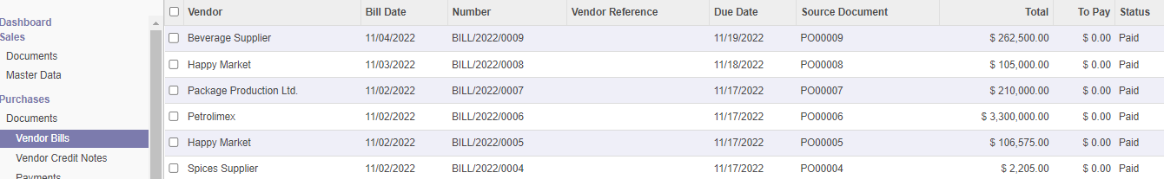
1/ After that, we check Vendor Bill and see that the bill for Beverage Supplier has been paid

Slide 33
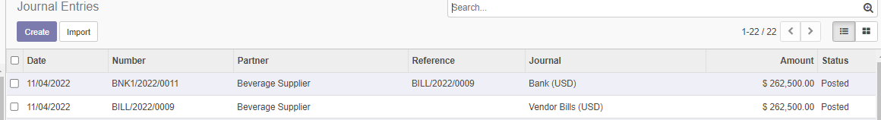
1/ A more detail payment can be found in Invoicing > Advisor > Journal Entries
2/ Beverage Supplier got a bill and a bank for that bill

Slide 35
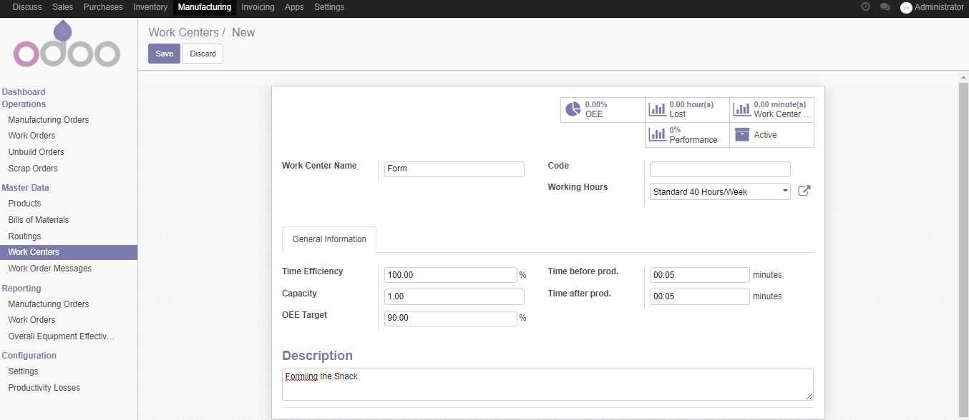
1/ Before we start Manufactoring, we will create a Work Center, these are processes for our production line
2/ We have 3 process called Form, Bake and Package
3/ Remember to add the code for

Slide 36
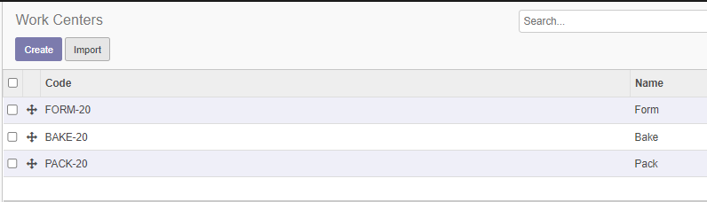
1/ After create individual work center, we have a list of Work Centers

Slide 37
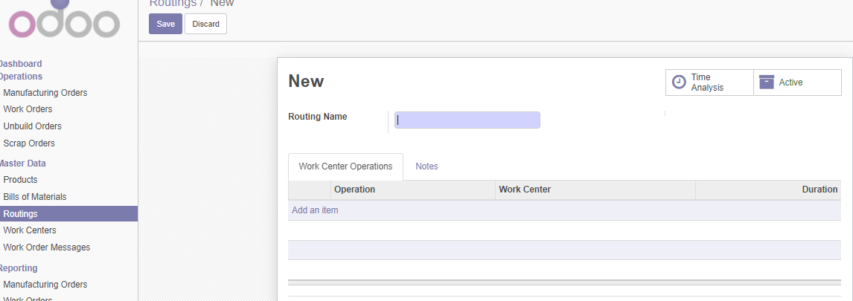
1/ We add the name as Snack production line
2/ After we have a list of Work Centers, we add all our Work Centers in Add an item

Slide 38
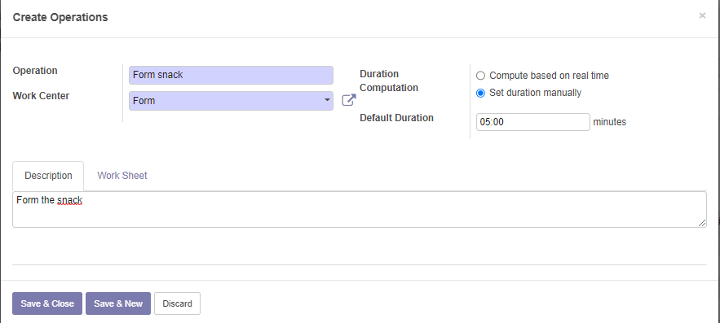
1/ This is the window to add the Work Center Form, we add the name Form snack
2/ Set the Duration as Manual
3/ We add the Description for this Work Center to this Route

Slide 39
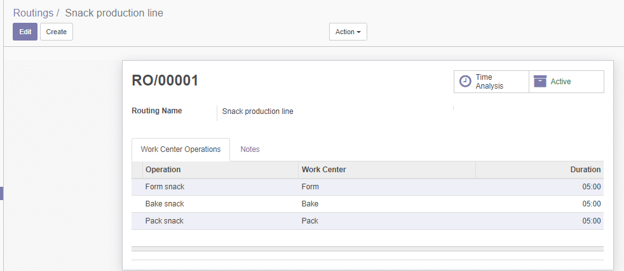
1/ This is the completed Route with 3 Work Centers, and it is called Snack production line

Slide 40
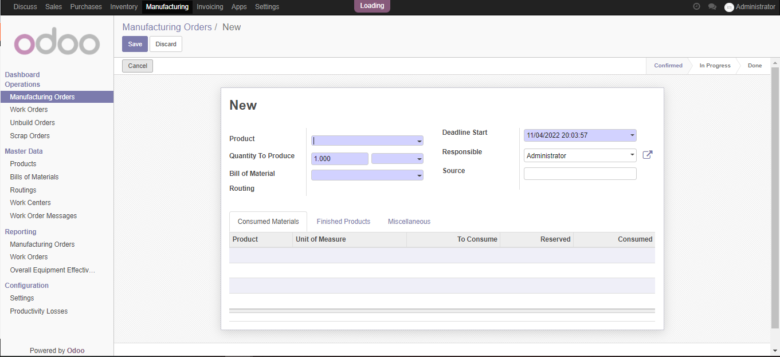
1/ We then create a manufacturing order by go to Manufactoring > Manufactoring Orders > Create
2/ Choose Product > Create and Edit to create a new product
3/ Quantity to Produde is the number of snack we want to produce (it will be adjusted automatically)
4/ Bill of Material will be added and Routing will be added in BOM

Slide 41
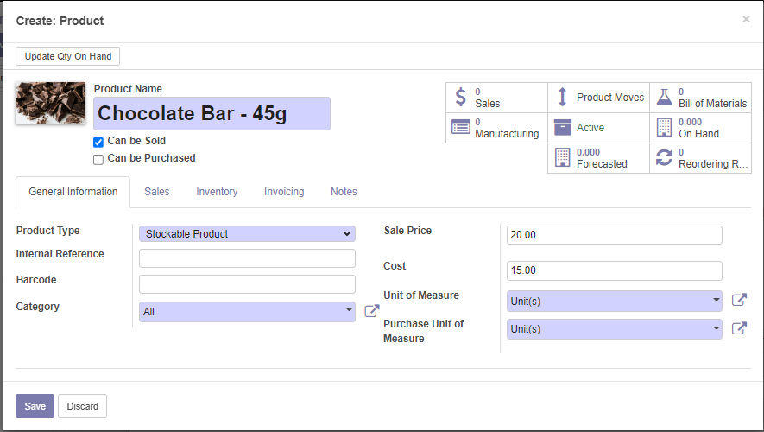
1/ This is create product for manufacturing
2/ Other information is the same as purchases so you do the similar
3/ Remember to uncheck the Can be Purchased and leave only Can be Sold checked

Slide 42
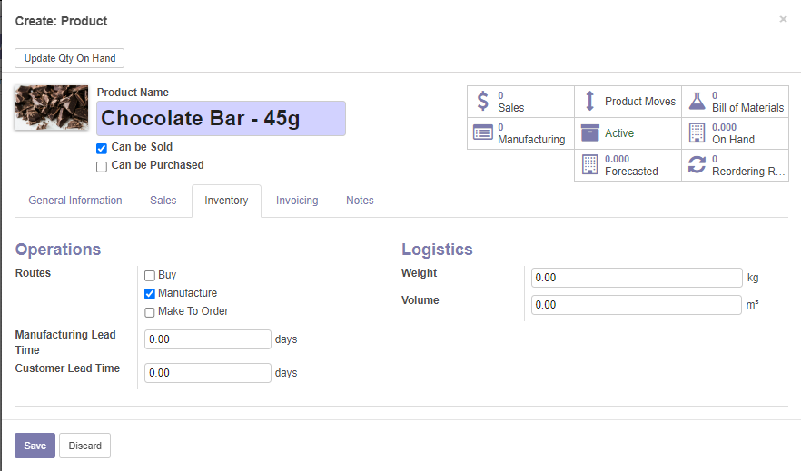

Slide 43
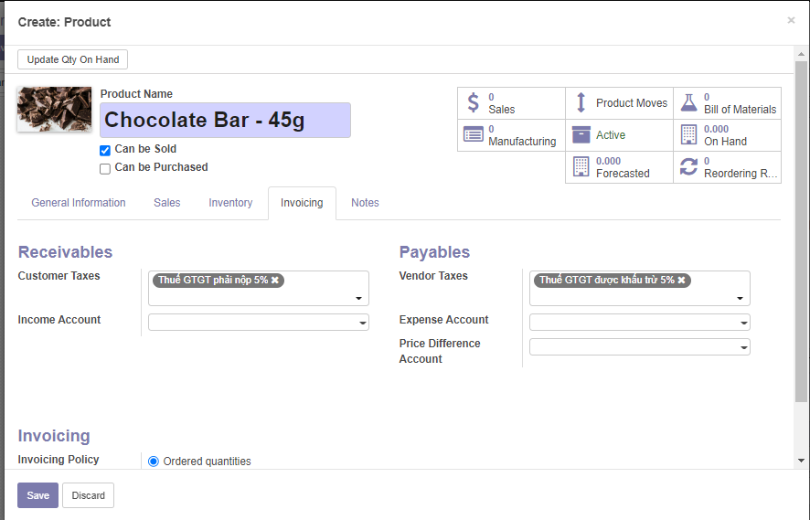

Slide 44
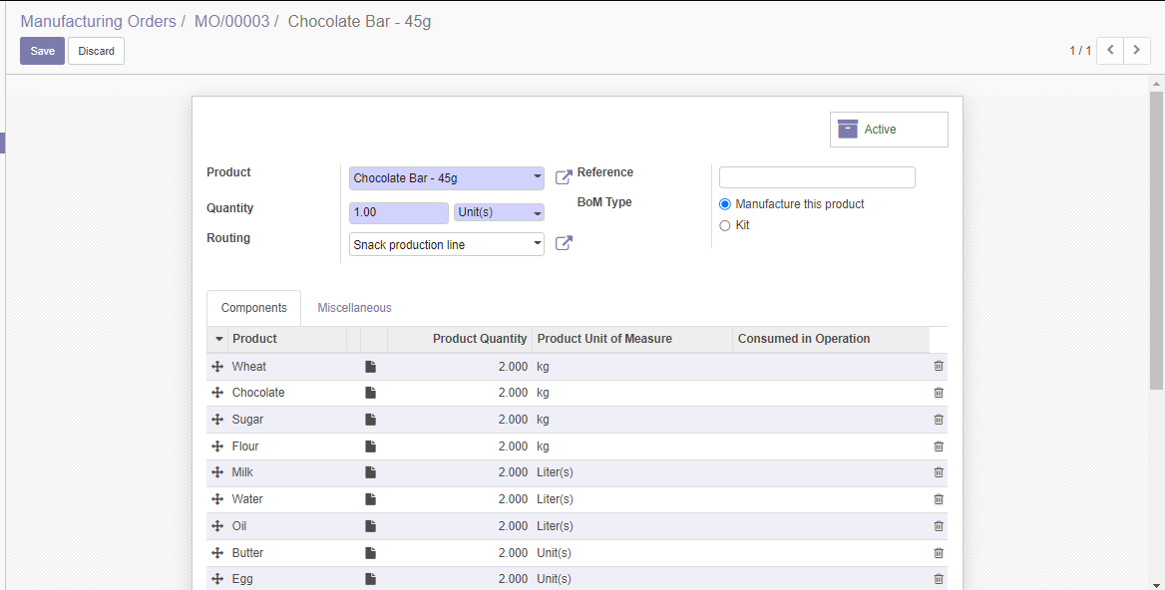
1/ This is the Bill of Material page, we add the product (the one we previously created), we add the quantity (how much should this line product at a time), routing we choose the Snack production line that we created before
2/ We add the list of materials in the line below
3/ We then save this Bill of Material

Slide 45
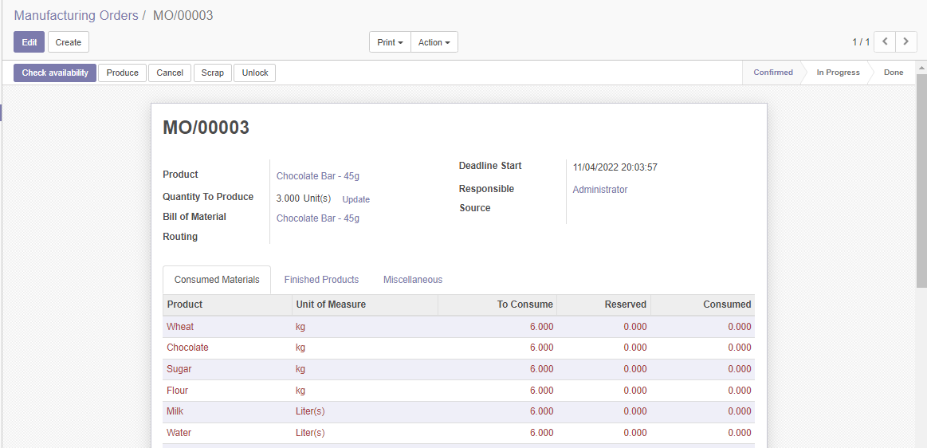
1/ This is the page after we finished, we need to check the availability for the reserved
2/ If we don’t have enough in the reserve, Odoo will not allow check availability, we need to add to go to purchase and buy the materials

Slide 46
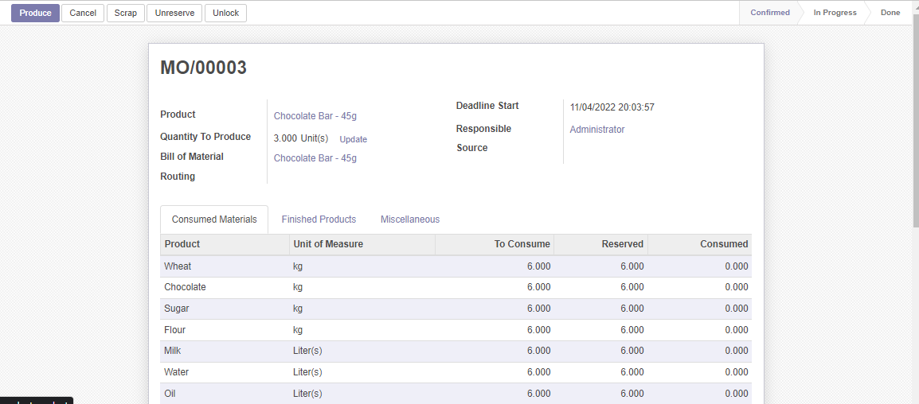
1/ After validation the text turn red to black
2/ We also have a Produce button
3/ Check the progress bar and see that we are on Confirmed

Slide 47
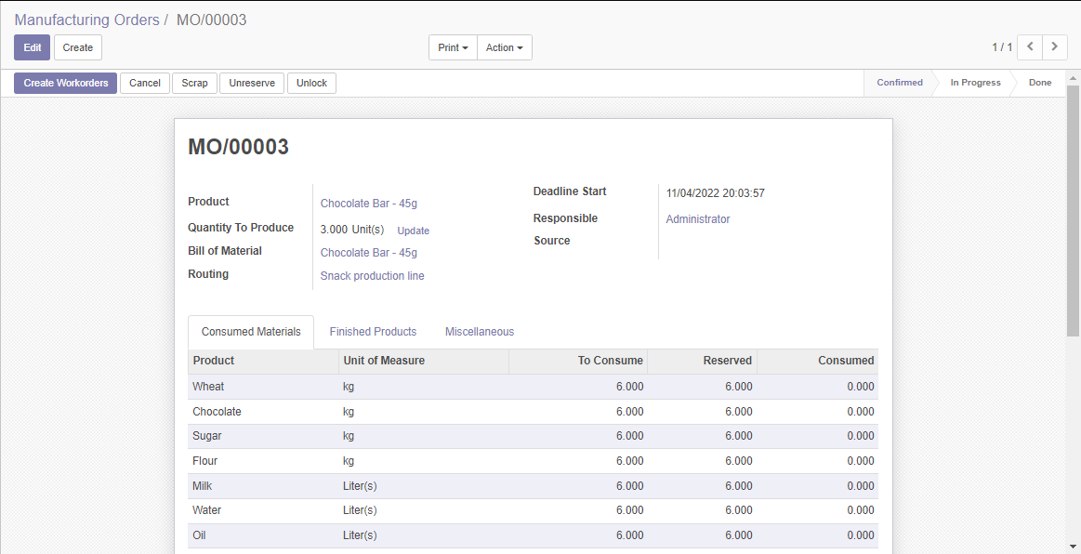
1/ This time after Produce, we move to the next which is Create Workorders

Slide 48
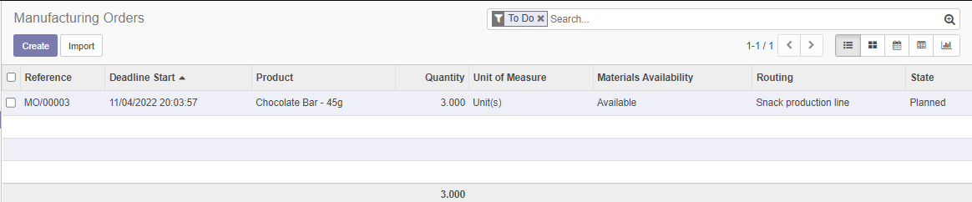
1/ This is the manufacturing orders, if we notice, we will see that the status is now planned
2/ We need to the Work Orders tab in the manufacturing to continue

Slide 49
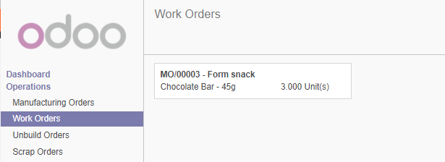
1/ In Work Orders, we see that we have an order for Form snack

Slide 50
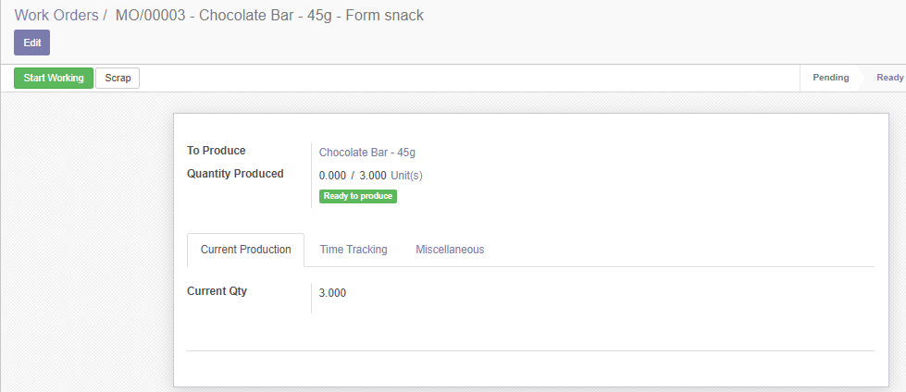
1/ With Form snack Work Order, we start the working process

Slide 51
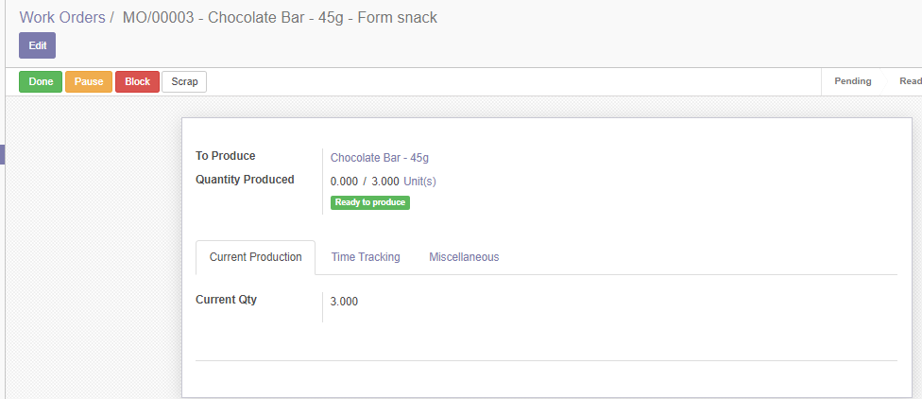
1/ This is the process of Forming snack
2/ Click done the finish the process

Slide 52
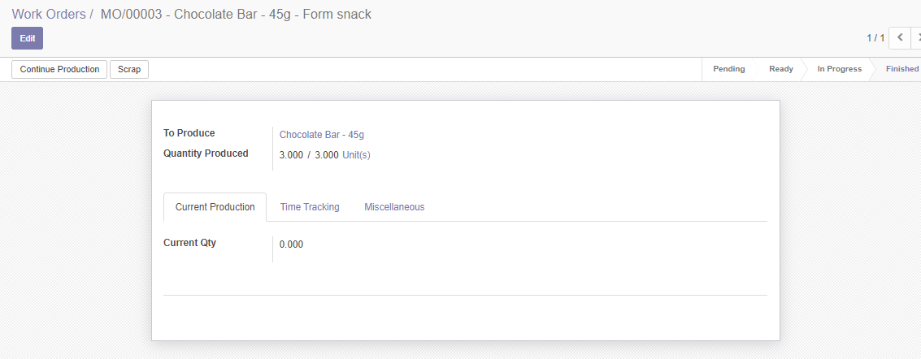
1/ This is the finished process, check the status below this notice, we see that it is Finished

Slide 53
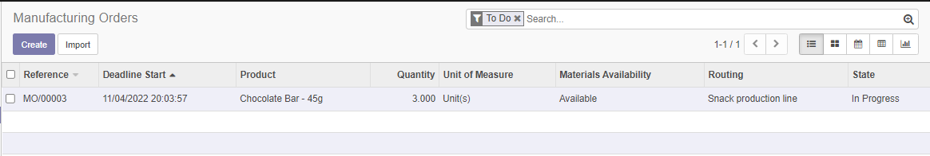
1/ Although it is finished the manufacturing is not finished, it is still In Progress because we need to still have 3 other processes

Slide 54
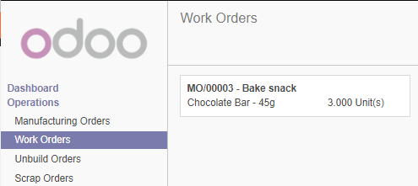
1/ This is the Bake snack process, we process is the same as the previous one so we will not talk about the process

Slide 55


Slide 56

1/ This is the Pack snack process, we process is the same as the previous one so we will not talk about the process

Slide 57


Slide 58

1/ The manufacturing is now completed with 3/3 work order and a Mark as Done button now appeared

Slide 59

1/ We check the inventory by going to Inventory tab > Reporting > Inventory Valudation > Retrieve the inventory valudation

Slide 60

1/ We see that we have Chocolate Bar – 45g with 3 unit cost about 45$

Slide 61

1/ The manufactured product also appeared in Sales > Products

Slide 62
1/ This the manufacturing process for Oats Bar – 40g, the process is similar so we will omitted from talking about the process but show pictures to demo

Slide 63


Slide 64


Slide 65

1/ Notice the Bill of Material is the different in the ingreedients

Slide 66


Slide 67

1/ It costs 2kg of each to create a 1 unit of Oats Bar, we need 3 units so Odoo automatically calculate for us to 6kg

Slide 68


Slide 69


Slide 70

1/ After finished, we have Chocolate Bar and Oats Bar

Slide 72

1/ Create a website we choose the basic form

Slide 73

1/ Publish is to publish the page so other public user can see
2/ New is to new a page (we will have new product after we install eCommerce)
3/ Edit is to edit the current page we are in

Slide 74

1/ This is to edit the page
2/ Click save to Save and Discard to cancel changes

Slide 75

1/ After finished, we have Chocolate Bar and Oats Bar

Slide 76

1/ We are on Adminstrative account, we have also installed eCommerce that is why in the shop we have products in our sales loaded in our shop
2/ These products are not publish to the public user

Slide 77

1/ We can add new product that are not in Sales

Slide 78

1/ Add new product name

Slide 79

1/ To publish product from sales to public customer

Slide 80

1/ This is the view that public customer see after you set up publish

Slide 82

1/ Check products in Sales, we see that Chocolate Bar – 45g has 3 units, Oats Bar – 40g has 3 units 2/ We preform Sales order via sales person

Slide 83

1/ Sales > Quotation > Create

Slide 84

1/ Fill information for Customer 2/ Choose the product you want to sales which is Chocolate Bar - 45g, quantity is 1 units

Slide 85

1/ Confirm sales will create Quotation to Sales Order
2/ Create Invoice will create the invoice for Register Payment

Slide 86

1/ From Invoice, we validate the invoice, the invoice will be as draft

Slide 87

1/ The draft invoice turn from Draft to Open

Slide 88

1/ Register Payment to turn the invoice into Paid status

Slide 89

1/ Register Payment to turn the invoice into Paid status

Slide 90

1/ We check the quantity of Chocolate Bar – 45g is now reduced to 2 units

Slide 91

1/ Check the Journal Entries, we see that INV means there are sales and BNK means the customer banked

Slide 93


Slide 94

1/ Go to the product on website

Slide 95

1/ Next we move to the Review Order

Slide 96

1/ Our customer is not in the database, so we need to fill in our public customer information

Slide 97

1/ Checking the Billing Address and Shipping Address of our public customer

Slide 98

1/ A customer is created and they have a new transaction

Slide 99


Slide 100

1/ This is the final page, thank you the customer for purchasing
2/ Notice Payment Information is pending, we will handle this

Slide 101

1/ In this, we see status is Quotation Sent

Slide 102

1/ From Quotation to Sales Order

Slide 103

1/ After we register payment and the status is now Paid

Slide 104

1/ Payment information is now updated to Done

Slide 105

1/ Our Oats Bar is now reduced to 2 units

Slide 107

1/ Install POS

Slide 108

1/ Create new session for the cashier

Slide 109

1/ Register Payment to turn the invoice into Paid status

Slide 110

1/ The cashier choose the product, select the customer and choose payment

Slide 111

1/ Customer

Slide 112


Slide 113


Slide 114


Slide 115


Slide 116


Slide 117


Slide 118


Slide 119


Slide 120


Slide 122


Slide 123


Slide 124


Slide 125


Slide 126


Slide 127


Slide 128


Slide 129


Slide 130


Slide 131


Slide 132


Slide 133


Slide 134


Slide 135


Slide 136


Slide 137


Slide 138


Slide 139


Slide 140


Slide 141


Slide 142


